Slide 1

Blue economy of Pakistan
Introduction
Potentail
Problem
conclusion

Slide 2
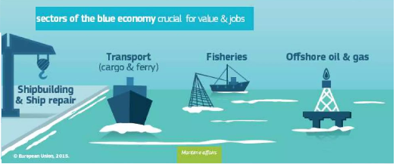
What is blue economy?

Slide 3
Blue economy in Pakistan
Pakistan is an important maritime state in the Indian Ocean blessed with approximately 1,050 km long coastline and the Exclusive Economic Zone covering about 240,000 sq.

Slide 4
Potentail of a Blue economy
sq.

Slide 5
How we solve our blue growth
sq.

Slide 6
Conclusion

